Slide 1

ONLINE BOOK STORE

Slide 2


Presented by: Team 2 Batch-90 Gayatri Jaiswal (Emp Id: 6242) Gaganashree Ram (Emp id: 6237) Prem Ganesh (Emp id: 6240) Gumit Rathore (Emp id: 6248) Harsh Nayak (Emp id: 6238) Donavalli Nani Babu (Emp id: 6250)

Slide 3
CONTENTS
Problem Statement
Implementation Technology
Project Requirement
Result
Importance of online book store
Pros and Cons
Future Enhancement
Conclusion

Slide 4
PROBLEM STATEMENT
Customers will use an web based interface to browse books based on categories, search books using keywords. Initially only the title and author of the book(s) are displayed, on click other attributes are displayed. Customers can buy books using their payment methods. The store also displays the number of copies of the book left in stock. Out of stock books cannot be purchased immediately, but can be ordered.

Slide 5
IMPLEMENTATION TECHNOLOGIES
Hardware Requirements:
Processor: 64 Bit
RAM: 2 GB
ROM: 256 GB
Software Requirements:
Eclipse
Microsoft Azure
Java
Html,css

Slide 6
PROJECT REQUIREMENT
The bookstore shall provide password protection for all accounts.
The bookstore shall provide the ability to search the master book catalog.
The bookstore shall provide a number of search methods on that catalog, including search by author, search by title, search by ISBN number, and search by keyword.

Slide 7

RESULT
HOME PAGE

Slide 8

REGISTER PAGE

Slide 9

ADMIN LOGIN

Slide 10

ADMIN LOGIN SUCCESSFUL

Slide 11

ADD BOOKS

Slide 12

REMOVE BOOKS

Slide 13

USER LOGIN

Slide 14
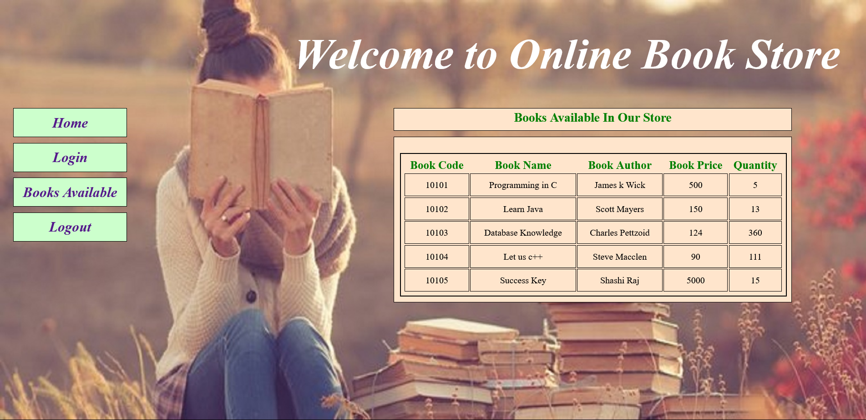
AVAILABLE BOOKS

Slide 15
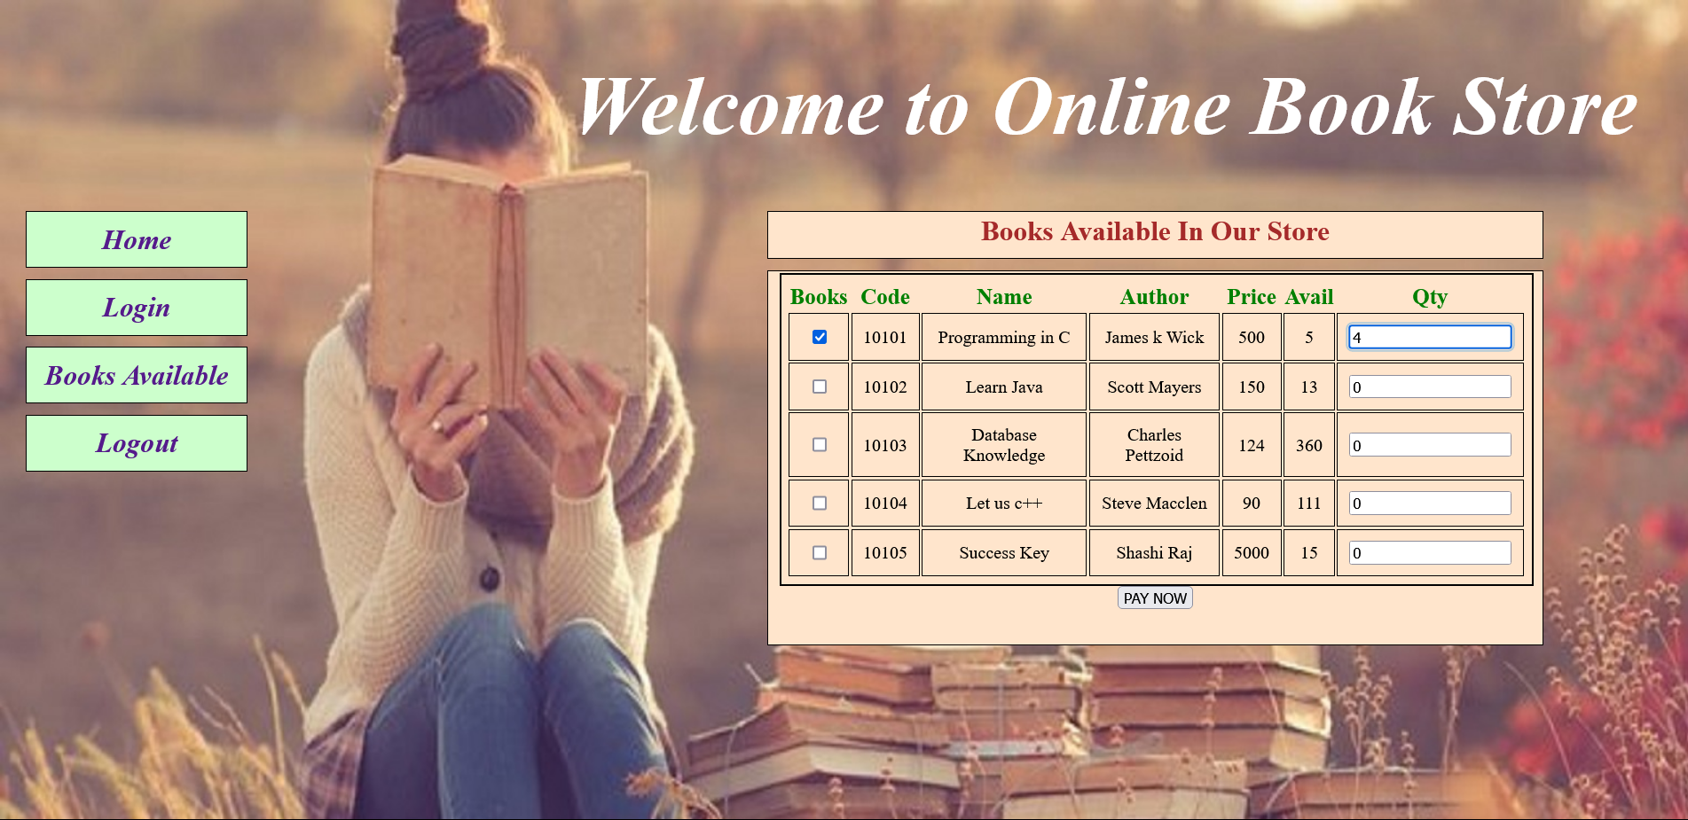
SELECT THE BOOK TO PURCHASE

Slide 16

RECEIVED THE BOOKING CONFIRMATION

Slide 17
IMPORTANCE OF ONLINE BOOK STORE
Customer Convience
Unlimited Capacity
Accessibility

Slide 18
PROS AND CONS
PROS:
No Limited Choice.
It is Easy to Access Consumer Reviews.
Global Availability.
CONS:
Lack of touch and feel of mechandis in online shopping.
Frauds in online shopping.
Delay in delivery.

Slide 19
FUTURE ENHANCEMENT
Maintained the books records.
Maintained the payment records.
Display the all the books present in the store.

Slide 20
CONCLUSION
The main objective of the Online Book Store is to manage the details of Books,Customer,Payment,Delivery,Bills. It manages all the information about Books, Stock, Bills, Books.
The purpose of the project is to build an application program to reduce the manual work for managing the Books,Customer,Stock,Payment.

Slide 21
THANK YOU

